Slide 1
Curso Desarrollo Office 365
Marzo 2015

Slide 2


Introducción a las Apps para SharePoint
Alberto Diaz Martin (@adiazcan)
Principal Team Leader en ENCAMINA
MVP de SharePoint Server

Slide 3
Agenda
Introducción al
modelo de Apps
Apps for SharePoint
Getting started
Notes:
What new APIs are available, in preview, in the Office 365 Platform
How to use these API’s in your platform of choice
Some sample business scenarios for leveraging these API’s
Level: Intermediate
Audience: Developer Essentials

Slide 4
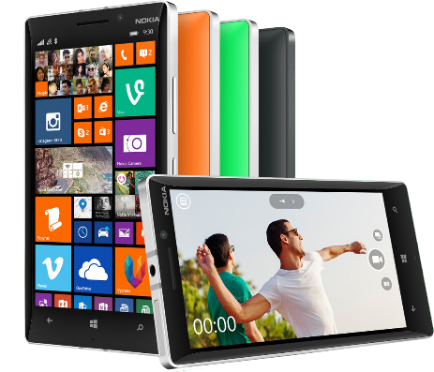


Plataforma desarrollo Office 365
Apps Contextuales
Office 365 APIs
Herramientas flexibles
Documents
Search
Mail
Social
Calendar
People
Notes:
Two kinds of apps :
you light up Office/Exchange/SharePoint.
You consume our services in a custom (device or web) app
Contextual apps
Rich, powerful interactive IW experiences
Do more, without leaving Excel, Outlook, PowerPoint, SharePoint
Consistent Framework everywhere that Office runs. Everywhere that people do work
Robust APIs
Big news
More for SharePoint Devs
Growing up outside SharePoint
Flexible Tools
Open-ness and choice is a core pillar
But … we just want to take away all the friction
Tools targeted to specific users
Platforms with best management, capability and scale
What does this mean. Where is the value
Breadth : more endpoints and experiences
Depth: richer APIs. More capabilities
Power:

Slide 5
Introducción al modelo de Apps

Slide 6
Apps Contextuales
Complementa las apps en Office 365
En context con las actividades de los usuarios de Negocio
En Cliente Office, Office Online, y Apps

Slide 7
Introducción al modelo de Apps
Las Aplicaciones SharePoint no “viven” en el servidor SharePoint
La ejecución del código personalizado se realizer en el cliente, en la nube o en on-premises
SharePoint da permisos a las Apps via Oauth
Las Apps se comunican con SharePoint via RES/CSOM
¿Cómo se instalan las Apps?
Catálogo de Aplicaciones
Tienda Office Pública (con un proceso de solicitud)
Despliegue manual
Notes:
To address many of the challenges developers and site owners had in previous versions of SharePoint, Microsoft has introduced a new development option for SharePoint 2013: The SharePoint App Model.
In this new model apps do not necessary live within SharePoint. Instead the app’s business logic executes within the context of the client (browser) or externally from SharePoint. This external option could be another non-SharePoint Web server or a cloud server. Apps are also more secure in that when they need to access SharePoint resources such as lists and libraries they must be explicitly granted permissions to do so. This is implemented using OAuth. When an app is created, the developer specifies which permission the app needs in order to function. When the app is installed, the user installing the app is prompted to accept the permission requests the app needs (if they deny the permissions, the app is not installed). Once granted permissions, the apps can then talk to SharePoint using the Client Side Object Model (CSOM) or using some of the new OData services in SharePoint.
Developers can build apps and submit them to a marketplace making it easy for customers to acquire these applications.

Slide 8






Desarrollo de App
Apps
Products and platforms
Services and data
Expense
calculator
Vacation
request
Event
planning
Help-desk
support
Learning management
Risk
management
App catalog and store
Notes:
It’s worth spending some time taking you through how we think about modern app development at Microsoft. We have a series of products and platforms like SharePoint and Office that provide a lot of great out-of-the box functionality to help us be productive. To get even more from these products we want to be able to bring information in from other places. Services and data sources like Dynamics, Bing or something that lives out on the web or in the cloud.
With the latest version of SharePoint we’re making it easier to bring together rich web services and data to create powerful new apps. Apps run outside of the SharePoint process, are hosted externally and can be exposed through REST API’s.
Today there are more than 700,000 SharePoint application developers and with this release we’re providing them with a place to surface their apps through an online marketplace of rich partner solutions and applications designed to work with SharePoint and Office.

Slide 9
demo
Añadiendo nuestra primera App

Slide 10
Apps for SharePoint

Slide 11
Bloques de construcción en SharePoint
Listas/Bibliotecas
Web Parts
Columnas de Sitios
Tipos de Contenido
Receptores de eventos remotos (Remote Event Receivers)
Workflows

Slide 12
Arquitectura de Apps
SharePoint
Azure
Web application
App 2
Web
App 2
SQL
App 2
Worker
Site collection
Root site
Apache
App 1
SP hosted
App 2
Provider hosted
App 3 Provider hosted
App 3
Web
App 3
mySQL
App 3
Worker
Sub site
IIS web server
App 3
Provider hosted
App 4
Provider hosted
App 4
Web
App 4
SQL
App 4 Windows service

Slide 13
Patrón Client-Side
SharePoint environment
Site collection
Lists
Site pages
CSS files
JavaScript files
Host web
App web
Notes:
The client-side pattern typically involves adding HTML pages, CSS files and JavaScript files to the app web. This makes it possible to add client-side code behind the pages of your app. You can also add quite a few other elements to the app web as well. Here is a short list of what you can add.
Site columns
Content types
List definitions
List instances
Site Pages
Web Part Pages
Web Parts
Custom Master Pages

Slide 14
Patrón Server-Side
SharePoint environment
Site collection
ASP.NET environment
On-premises or in Microsoft Azure
SQL server
On-premises data
Host web
Remote
web
Managed code
C# or VB
IFrame
SQL server
Cloud-based data
App web
Remote
web
Managed code
C# or VB
IFrame
Client-side object model calls
Notes:
The server-side pattern is great for experienced .NET developers because they are able to write strongly-typed code using C# and VB.NET. You also have the flexibility of picking your preferred execution environment (e.g. .NET 4.0, .NET 4.5, etc.) and not being constrained by all the frustrating limitations if running code inside the SharePoint environment.
In some scenarios, the external application associated with a SharePoint app will be self-contained which means it has not need to call into SharePoint to access content. In other scenarios, the external application associated with a SharePoint app will be required to call back into SharePoint to read and write content such as list items and/or documents within the host web or the app web.

Slide 15
Patrón Hybrid
SharePoint environment
Site collection
ASP.NET environment
On-premises or in Windows Azure
SQL server
On-premises data
Host web
Remote
web service
Managed code
C# or VB
Custom JavaScript
SQL server
Cloud-based data
App web
Remote
web service
Managed code
C# or VB
Custom JavaScript
Client-side object model calls
Notes:
The hybrid pattern is the most flexible. You can mix and match as much client-side code and server-side code as you would like.

Slide 16
Provider versus SharePoint hosted
Provider hosted apps
Provider hosted apps
SharePoint hosted apps
Modelo preferido para casi todos los tipos de Apps
Buena elección para aplicaciones pequeñas y almacenamiento de recursos
Todo el poder de la web — elige tu infraestructura y tecnología
Basadas en SharePoint; sin código de servidor
Puede requerir tu propio hosting
Hospedadas automáticamente
en SharePoint
Puede requerir el control del multitenancy y la administración de permisos
multitenancy y aislamiento heredado

Slide 17
Aislamiento de Aplicaciones
Cuando se provisionan las Apps, se crea una nueva SPWeb (AppWeb) created hospedada en SPWeb
Cada App reside en su propio SPWeb por aislamiento
Configuración DNS especial (app-123456.apps.misharepoint.com)
El SPWeb de la App vive en dominios separados (DNS)
Cada App se hospeda en su propia URL única porque
Blocks XSS: aislamiento a SPWeb bajo bloqueos de dominios especiales
Garantiza los permisos de las apps: las Apps se comunica con los sitios via CSOM/API y debén de concederse permisos para eso
Notes:
When an app is installed, SharePoint creates a special SharePoint site (SPWeb) for the app. This site, called an AppWeb, is given it’s own top-level URL that is different from the hosting site. This unique URL enforces two things:
Blocking cross site scripting (XSS) – because the hosting site & the AppWeb are in different domains, browsers will block any script that tries to access resources in different domains.
Enforcing App Permissions – apps will only be allowed to access SharePoint sites if they have been granted access to do so and when they do, they can access it using the CSOM or OData APIs.

Slide 18
Entendiendo la URL de la App
Escenario:
App instalada en https://intranet.contoso.com
Disección de la URL de la App:
https://tenant-APPUID.domain.com/APPNAME
https://app-bf473b5225nn0f.contoso.com/SharePointAppTitle
APPUID
APPNAME
ID único para cada instalación de la App en el tenant
Permite que cada dominio de app sea único
Nombre del SPWeb donde la App es instalada
Desarrolladores tienen el control
Notes:
Consider an app installed in the SPWeb http://intranet.contoso.com
The app URL will be (for example): http://app-bf473b5225nn0f.apps.contoso.com/SharePointAppTitle
Dissecting the App URL (use http://fabrikam-APPUID.SharePoint.com/APPNAME in the following explanation):
APPUID: A unique 14 character identifier that is given to each app installation in that particular customer / tenancy. This makes the domain unique for each app.
APPNAME: The name of the SPWeb folder under which the app is installed. Currently this is a GUID and is automatically generated.
On-Premises Deployment:
In the case of an on-premise deployment, everything in the domain except APPUID is configurable by the administrator; administrators can specify tenant & domain.com in the above scenario. This is set once while preparing the farm to support apps.
Developers have control over the APPNAME within the AppManifest file of the app package.
Apps should be used with SSL when deployed to production.
Hosted / Office 365 Deployment:
In the case of a hosted deployment, the customer name (or tenant name) is determined when they create their account with Office 365 and it is not changed after that. The root domain (domain.com in the above scenario) is always SharePoint.com.

Slide 19
Puntos de Entrada de una App
Puntos de entrada
Página de inicio
App Parts
Comandos personalizados de UI
El Control Chrome
Usemos el control Chrome para heredar estilos y enlaces del Host Web en una aplicación cloud
Notes:
20488A
08: Introducing Apps for SharePoint

Slide 20
Las APIs de cliente de SharePoint
Lists and libraries
User profile
Search
Taxonomy
Feeds
…
_api
Execute query
REST/ OData
JavaScript library
Silverlight library
.Net CLR library
Custom client code

Slide 21
Alcance de una App
Web scope
Puede registrar y usar recursos del sitio padre o colección de sitios
Tenant scope
Puede registrar la página de inicio, acciones personalizadas
Administradores del Tenant puede habilitar el acceso
(SharePoint-hosted tenant-scope apps no soportado)
Notes:
Another consideration when building apps involves the scope of the app. Will the app be scoped to a SharePoint site (or a web) as a document library is, or will it be tenant scoped. Tenant scoped means that the app may contain data for multiple tenants (customers) and partition each experience per customer.
Tenant scoped apps can not reside in SharePoint… these types of apps can only be implemented as cloud apps.

Slide 22
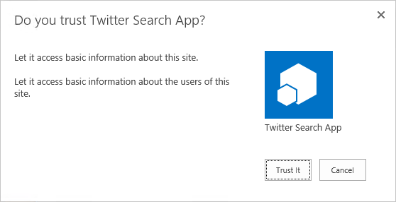
Apps en la jerarquía de una colección de sitios
1
3
app
2
2
https://*.contosoapps.com
4
https://intranet.contoso.com/sites/team
4
Root
https://intranet.contoso.com/sites/groupx
Sub site
AppWeb
Root
News
Organization
Teams
Search
AppWeb

Slide 23
App de despliegue centralizado
1
3
app
2
https://*.contosoapps.com
https://intranet.contoso.com/sites/catalog
Root
https://intranet.contoso.com/sites/team
AppWeb
AppWeb
Root
4
Sub site
https://intranet.contoso.com/sites/orgZ
4
Root
News
Organization
Teams
Search
AppWeb

Slide 24
Empaquetando y publicando Apps
Empaquetando Apps
Extensión .app — un paquete típico incluye los siguientes archivos:
AppManifest.xml
AppIcon.png
Fichero de solución
Publicando Apps
Office Store
App catalogs
Notes:
20488A
08: Introducing Apps for SharePoint

Slide 25
Llamadas cross domain
Usando la librearía de cross domain
Acceso al contenido de la App Web desde JavaScript en una web remota
SP.RequestExecutor.js
AppWebProxy.aspx
Usando el proxy web
Acceso al contenido en SharePoint o donde sea desde JavaScript en una web remota
SP.WebRequestInfo
Sólo Dominios de confianza para llamadas cross domain
Notes:
20488A
08: Introducing Apps for SharePoint

Slide 26

Authentication
SharePoint
Azure
Web application
App 2
Web
App 2
SQL
App 2
Worker
Site collection
Root site
Apache
App 1
SP hosted
App 2
provider hosted
App 3 provider hosted
App 3
Web
App 3
mySQL
App 3
Worker
Sub site
IIS web server
App 3
provider hosted
App 4
provider hosted
App 4
Web
App 4
SQL
App 4
Windows service

Slide 27
Versionado
SharePoint
Azure
Web application
App 2
SQL
V2.0.0.0
App 2
Worker
V2.0.0.0
App 2
SQL
V3.0.0.0
App 2
Worker
V1.0.0.0
App 2
Web
V3.0.0.0
App 2
Worker
V3.0.0.0
App 2
Web
V2.0.0.0
App 2
Web
V1.0.0.0
App 2
SQL
V1.0.0.0
Site collection
Root site
Apache
App 1
V1.0.0.0
App 1
V2.0.0.0
App 1
V3.0.0.0
App 3 V3.0.0.0
App 3 V2.0.0.0
App 2
V1.0.0.0
App 3 V1.0.0.0
App 2
V2.0.0.0
App 2
V3.0.0.0
App 3
Web
V2.0.0.0
App 3
SQL
V2.0.0.0
App 3
worker
V2.0.0.0
App 3
Web
V3.0.0.0
App 3
SQL
V3.0.0.0
App 3
worker
V3.0.0.0
App 3
Web
V1.0.0.0
App 3
SQL
V1.0.0.0
App 3
worker
V1.0.0.0
Sub site
IIS web server
App 4
V2.0.0.0
App 4
V1.0.0.0
App 3
V1.0.0.0
App 4
Web
V1.0.0.0
App 4
SQL
V1.0.0.0
App 4
Web
V2.0.0.0
App 4
SQL
V2.0.0.0

Slide 28
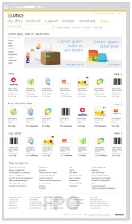
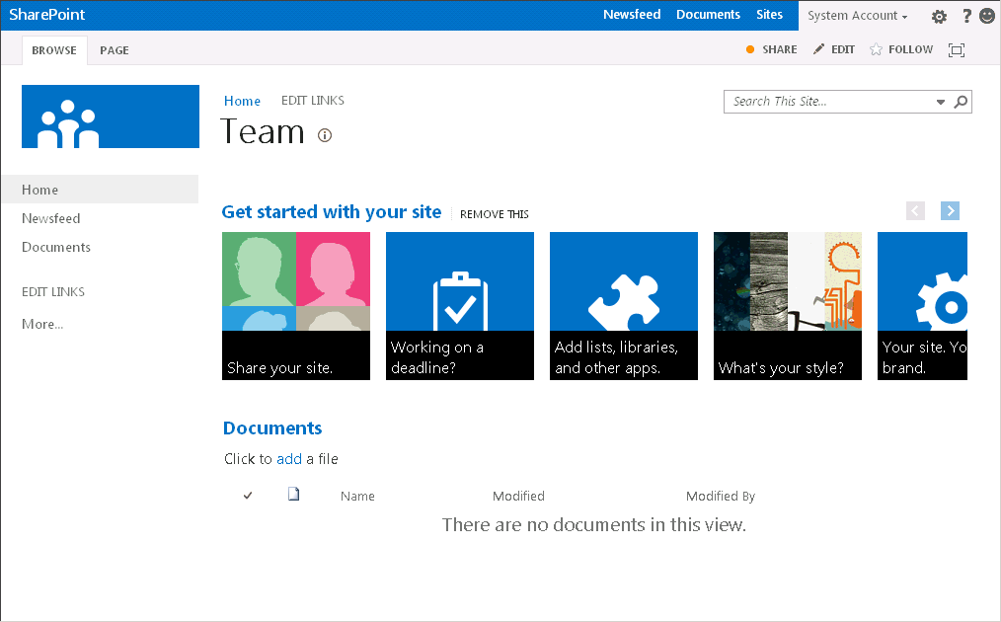
Proceso de actualización
Meetings app
V2.0.0.0
Marketplace
App 1.0.0.0
Meetings app
V1.0.0.0
App 1.0.1.0
Meetings app
V1.0.0.0
Meetings app
V2.0.0.0
Child Site A
Parent site
Child Site B
Child Site C
New version available

Slide 29
App scopes
SPSite—site collection
SPWeb—website
SPList—list
Tenancy—the tenancy scope is at http://<sharepointserver>/<content>/<tenant>/
performing search queries, accessing taxonomy data, user profiles, etc.
Notes:
An app uses permission requests to specify the permissions that it needs
The requests specify both the rights and scope which are needed
Scopes indicate where in the SharePoint hierarchy a permission request applies. SharePoint supports four different content scopes:
SPSite—site collection
SPWeb—website
SPList—list
Tenancy—the tenancy scope is at http://<sharepointserver>/<content>/<tenant>/
There are also scopes for things like performing search queries, accessing taxonomy data, user profiles, etc.

Slide 30
App rights
Rights
Read-only
Write
Manage
Full control (not supported in Store)
Not customizable if an app is granted permission to a scope
The permission applies to all children of the scope
Notes:
Permission rights indicate what an app is permitted to do within a scope. SharePoint supports four rights levels for content (there are others for things like search, term store, etc.):
Read-Only
Write
Manage
Full Control
Unlike SharePoint user roles, these rights levels are not customizable
If an app is granted permission to a scope, the permission applies to all children of the scope
If an app is granted perms to an SPWeb, the app is also granted perms to each SPList in the SPWeb, and all SPListItems in each list, but NOT each subweb

Slide 31
Setting app rights
App rights are set when
An app is installed by an SPWeb administrator
An app is explicitly granted permission by a tenant administrator or SPWeb administrator
An end-user gives consent
An app is removed
Once provisioned, the rights for an app cannot change—they can only be revoked in whole
This ensures the app will not have to account for missing rights, i.e., become broken after installation

Slide 32
Formas de una App for SharePoint
Página completa
Implementa experiencia complete para satisfacer escenarios de negocio
Parts
Creamos App Parts que pueden interactuar con la experiencia de SharePoint
Extensiones UI command
Añadimos nuevos commandos a la ribbon o menu de elemento

Slide 33
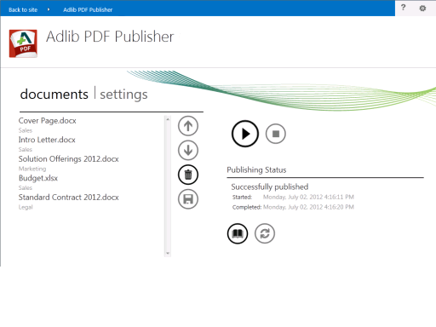
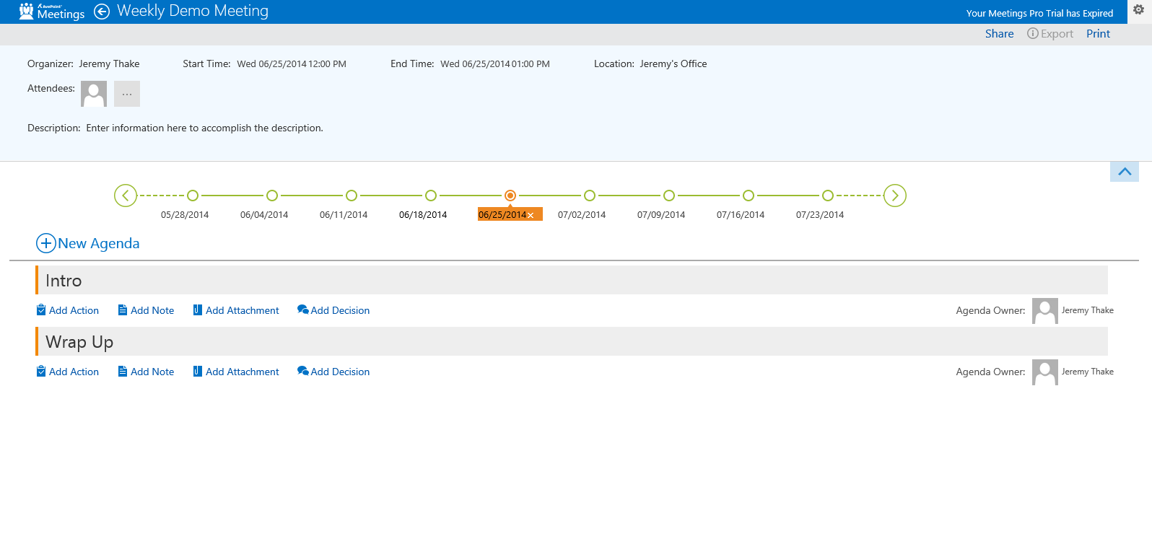

Slide 34
Formas de una App for SharePoint
Página completa
Implementa experiencia complete para satisfacer escenarios de negocio
Parts
Creamos App Parts que pueden interactuar con la experiencia de SharePoint
Extensiones UI command
Añadimos nuevos commandos a la ribbon o menu de elemento

Slide 35
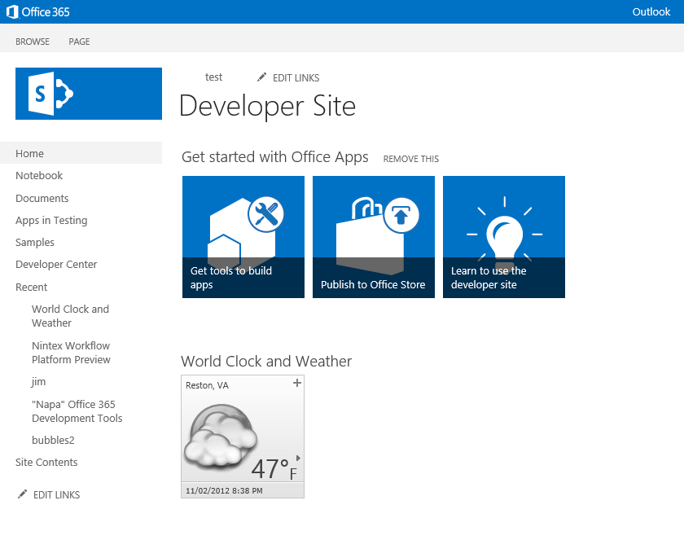
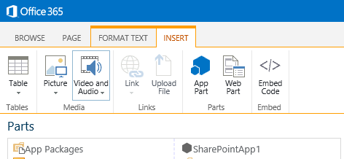

Slide 36
Formas de una App for SharePoint
Página completa
Implementa experiencia complete para satisfacer escenarios de negocio
Parts
Creamos App Parts que pueden interactuar con la experiencia de SharePoint
Extensiones UI command
Añadimos nuevos commandos a la ribbon o menu de elemento

Slide 37
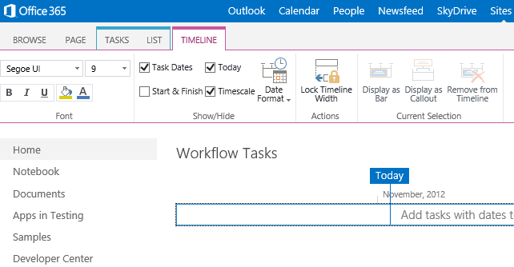

Slide 38
demo
Ejemplos de Apps para SharePoint

Slide 39
Getting started

Slide 40
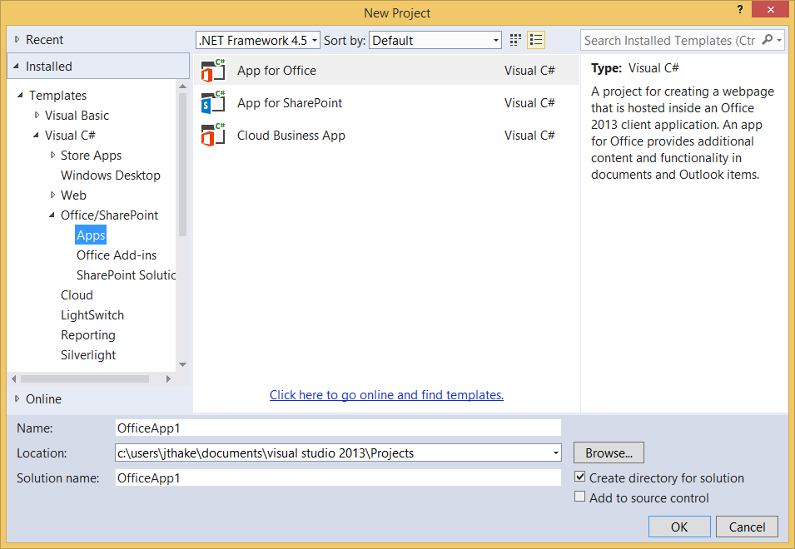
Visual Studio 2013

Slide 41
Entorno
Office 365 developer tenant
Office 365 individual developer site collection
On-premises SharePoint server

Slide 42
demo
Construyendo la primera app for SharePoint

Slide 43
Conclusiones
Implementemos nuestras soluciones de negocio en Office 365
Aprovechando las capacidades de la plataforma
Usando la plataforma de desarrollo que necesites

Slide 44
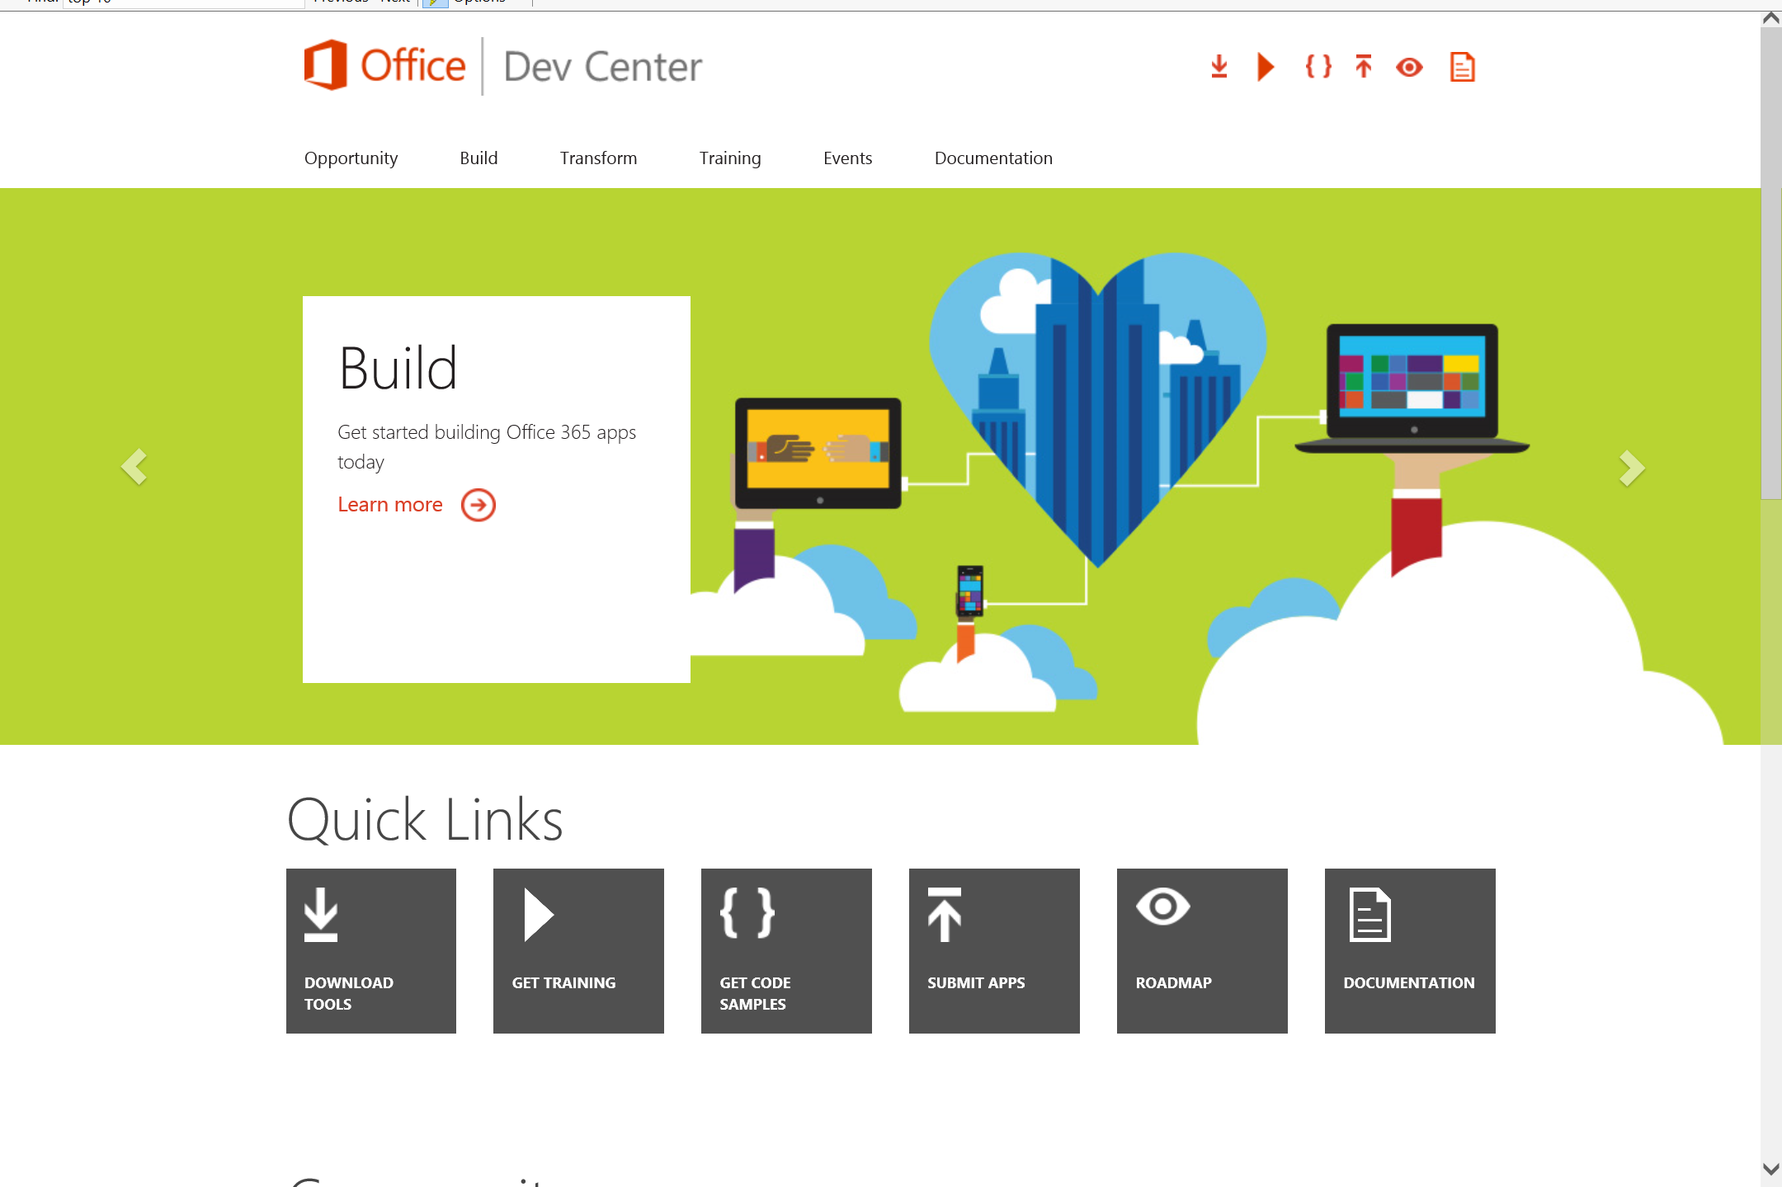
Dev.
Office
.com
One stop shop for Office Developer Platform

Slide 45

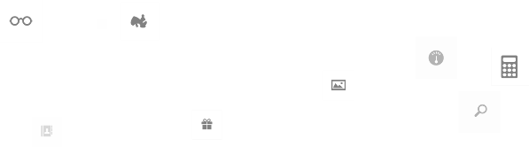
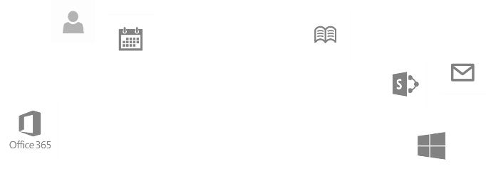
Calls to action
Explore our developer center
http://dev.office.com
Jumpstart into our training http://dev.office.com/training
Play with our code samples http://dev.office.com/code-samples
Get answers
http://aka.ms/AskSharePoint
http://aka.ms/AskOffice
Give feedback Drive our roadmap http://aka.ms/OfficeDevFeedback

Slide 46

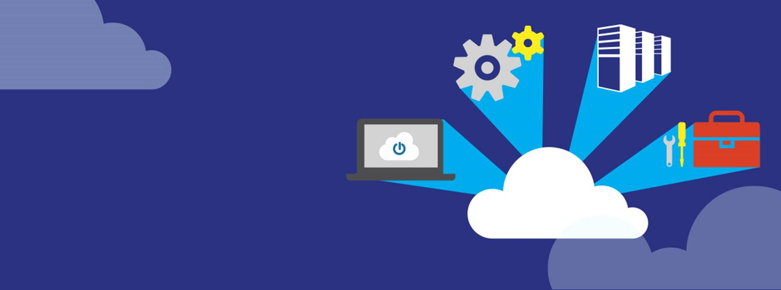
Transform your code Providing App Model Patterns for common Full Trust Code scenarios
60+ Visual Studio projects Common scenarios
Branding
Site provisioning
Remote event receivers
Large file support
Taxonomy driven navigation
And much more…
Contribute
Open source coming soon!
Developer
Patterns & Practices
aka.ms/OfficeDevPnP

Slide 47
Microsoft Virtual Academy courses
2014
2015
Deep Dive into integrating Office 365 APIs with your mobile device development
Deep dive into the building blocks and services of the SharePoint platform
Deep Dive into integrating Office 365 APIs with your standalone web application development
Introduction to Office 365 Development
Deep Dive into the Office 365 App Model
Deep Dive into Office 365 Development on non-Microsoft Stack
Shipping your Office 365 App to the Office Store
Aug
Sept
Oct
Nov
Dec
Jan
Feb

Slide 48

© 2014 Microsoft Corporation. All rights reserved. Microsoft, Windows, and other product names are or may be registered trademarks and/or trademarks in the U.S. and/or other countries.
The information herein is for informational purposes only and represents the current view of Microsoft Corporation as of the date of this presentation. Because Microsoft must respond to changing market conditions, it should not be interpreted to be a commitment on the part of Microsoft, and Microsoft cannot guarantee the accuracy of any information provided after the date of this presentation. MICROSOFT MAKES NO WARRANTIES, EXPRESS, IMPLIED OR STATUTORY, AS TO THE INFORMATION IN THIS PRESENTATION.

